Slide 1

Mindful Echo: AI Mental Health Chatbot

Slide 2

Introduction
1.Mental health challenges are increasing in today’s world.
2.Many people hesitate to share their feelings due to stigma or fear of judgment.
3.Mindful Echo provides a safe, empathetic, and non-judgmental space to talk.
4.Built using AI to support users emotionally – anytime, anywhere.
Mental health challenges are increasing.
Many hesitate to share feelings.
Mindful Echo: Safe, empathetic space.
24/7 AI emotional support.

Slide 3


Objective
-Create a supportive chatbot for mental well-being.
-Listen actively and respond with compassion.
-Encourage general wellness practices without giving medical advice.
-Ensure user privacy, safety, and emotional comfort.

Slide 4

Tools, Data & API
-API Used: Groq API with models like llama3-8b-8192
-Frameworks: LangChain for conversation handling
-Frontend: Streamlit for web-based chat interface
-Security: .env & Streamlit secrets to manage API keys

Slide 5

Methodology
-Designed a custom system prompt to guide chatbot behavior
-Used ConversationBufferMemory to remember past chats
-Handled user input through Streamlit chat interface
-Added session handling, error management, and API fallback

Slide 6
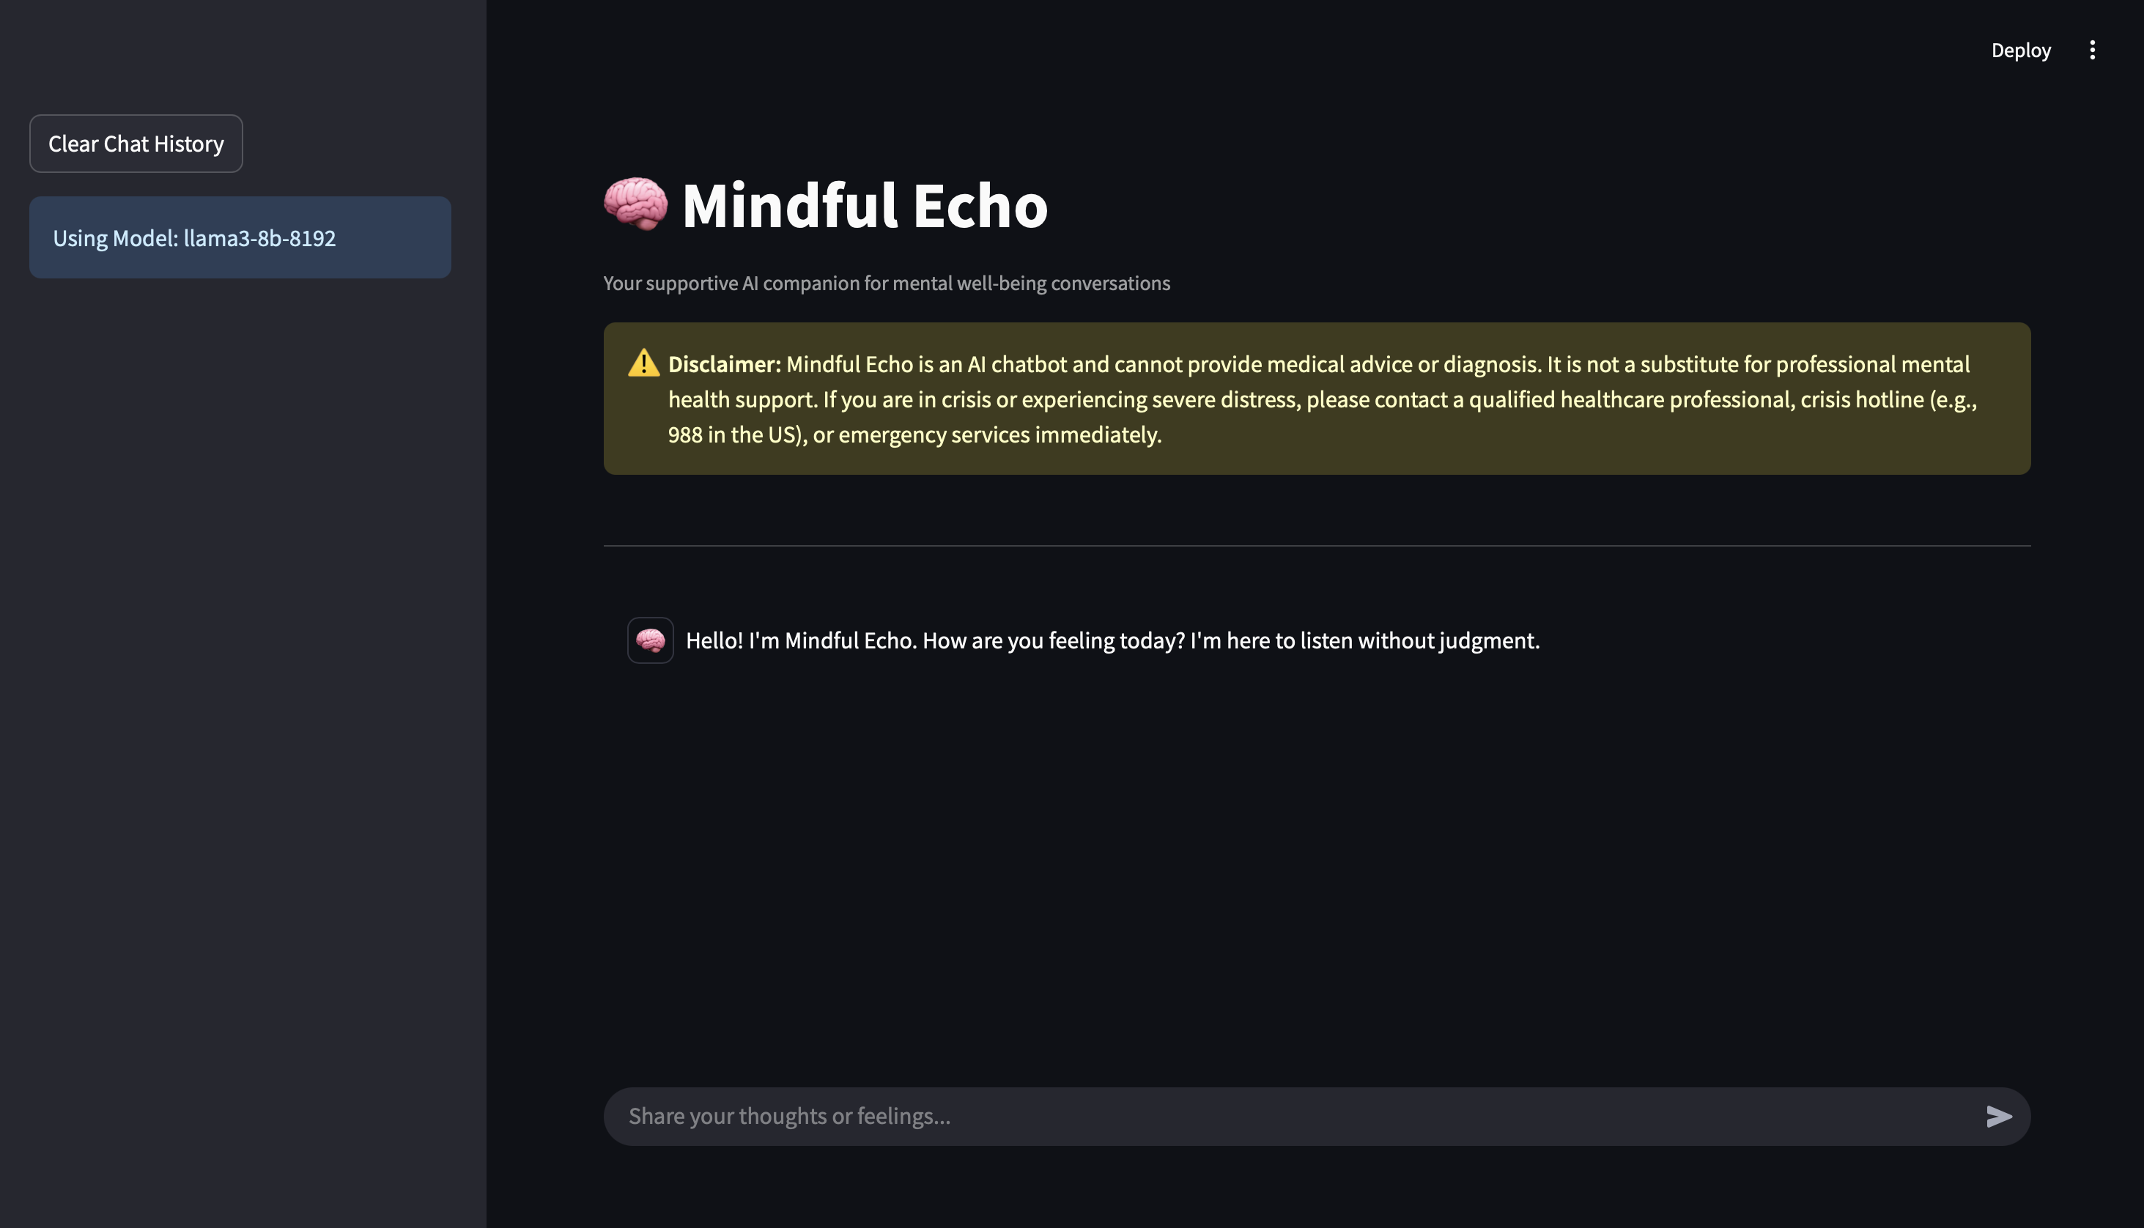
Result (Screenshot)

Slide 7
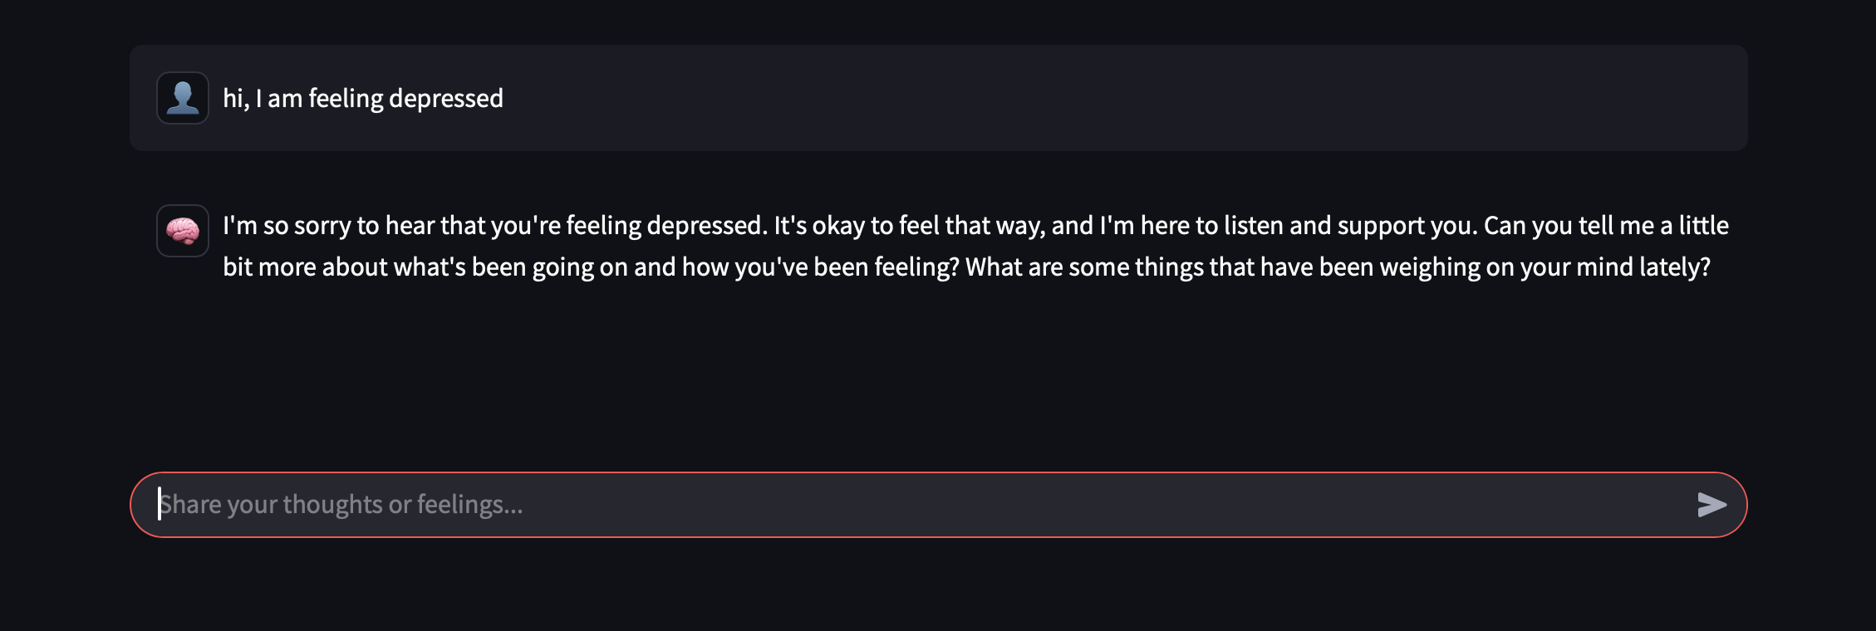
Results

Slide 8

Conclusion
Conclusion:
Mindful Echo creates a friendly, accessible support system for emotional expression.
Future Scope:
Add multilingual support
Integrate mood tracking and journaling
Build a mobile version for easier access

Slide 9

THANK YOU

